Slide 1
NAZISM AND RISE OF HITLER
Notes:
RAHUL DEV PGT HISTORY
JNV DAHOD-1

Slide 5
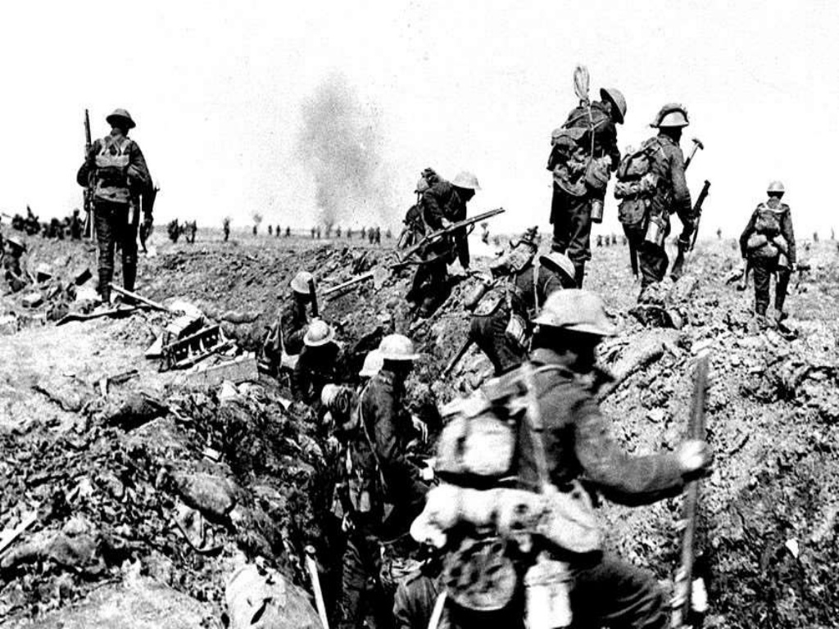

Slide 27
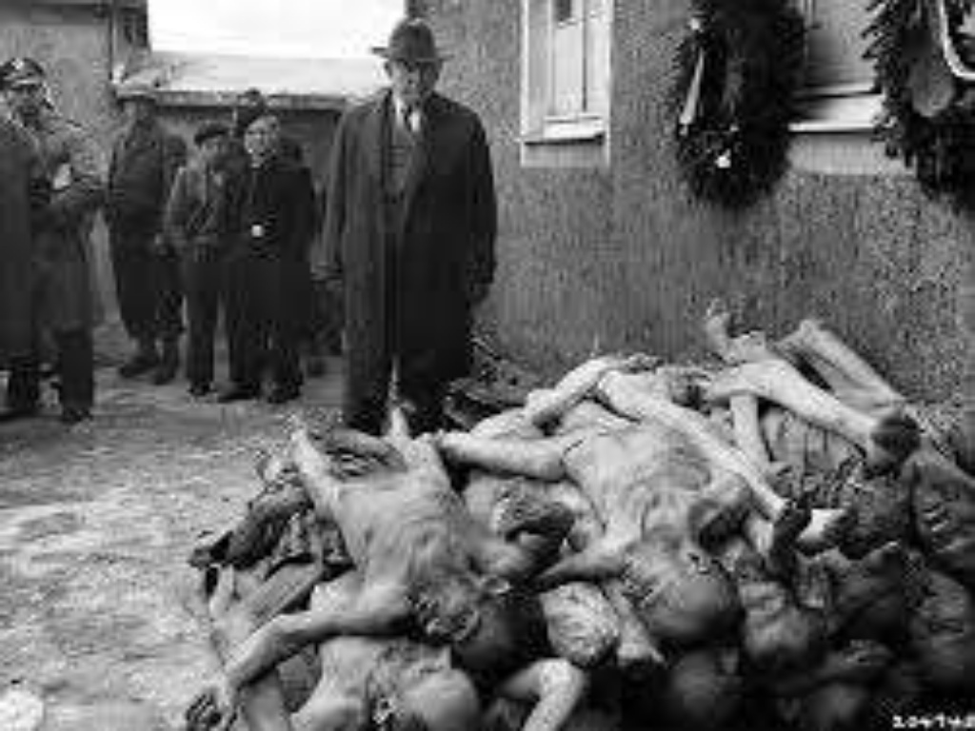

Slide 28
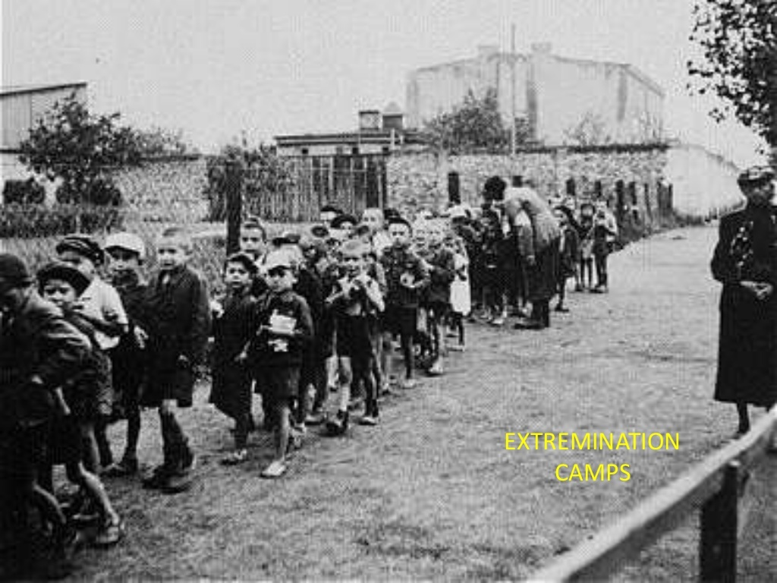

Slide 29
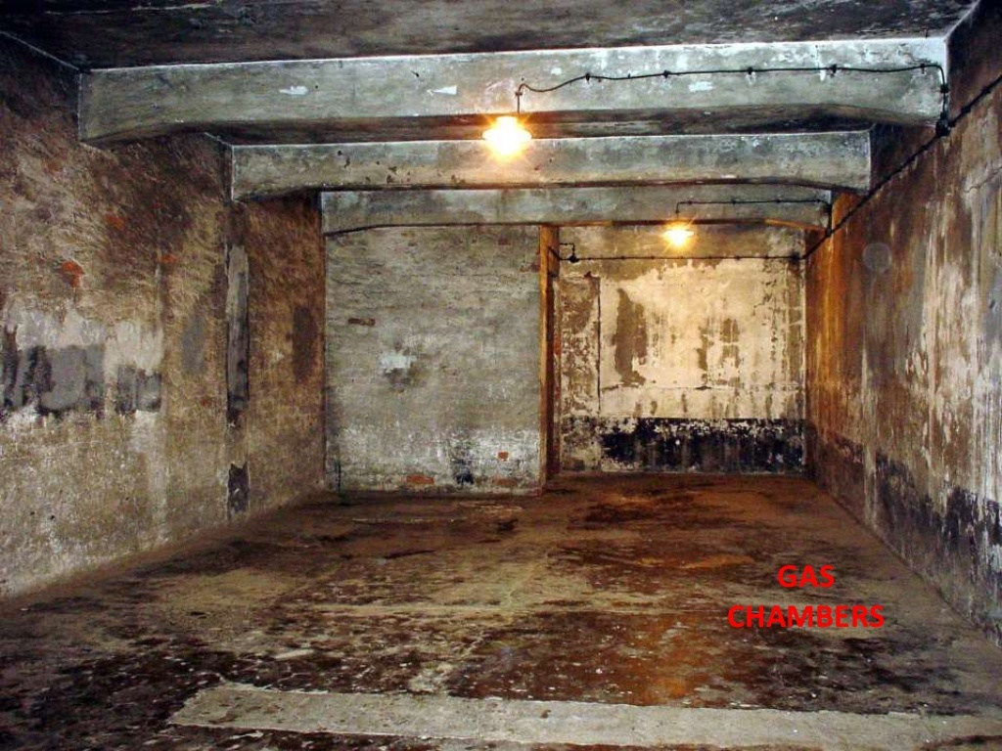

Slide 32
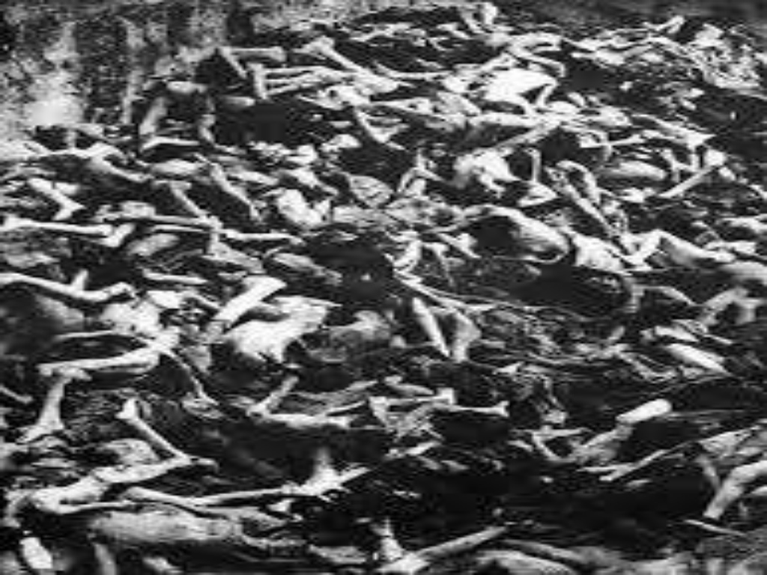

Slide 34
